Slide 1
Connectionist Computing
COMP 30230/41390
Gianluca Pollastri
office: CASL, ground floor Science East.
email: gianluca.pollastri@ucd.ie
Connectionist Computing COMP 30230

Slide 2



Credits
Geoffrey Hinton, University of Toronto.
  borrowed some of his slides for “Neural Networks” and “Computation in Neural Networks” courses.
Ronan Reilly, NUI Maynooth.
  slides from his CS4018.
Paolo Frasconi, University of Florence.
  slides from tutorial on Machine Learning for structured domains.
Connectionist Computing COMP 30230

Slide 3
Lecture notes on Moodle
https://csmoodle.ucd.ie/moodle/course/view.php?id=288
Strictly confidential...
Enrolment key: 30230cc
Connectionist Computing COMP 30230

Slide 4
Books
No book covers large fractions of this course.
Parts of chapters 4, 6, (7), 13 of Tom Mitchell’s “Machine Learning”
Parts of chapter V of Mackay’s “Information Theory, Inference, and Learning Algorithms”, available online at:
http://www.inference.phy.cam.ac.uk/mackay/itprnn/book.html
Chapter 20 of Russell and Norvig’s “Artificial Intelligence: A Modern Approach”, also available at:
http://aima.cs.berkeley.edu/newchap20.pdf
More materials later..
Connectionist Computing COMP 30230

Slide 5
Marking
3 landmark papers to read, and submit a 10-line summary on Moodle about: each worth 6.67%
a small connectionist tool to build and play with: 30%
Final exam: 50%
Connectionist Computing COMP 30230

Slide 6
Programming assignment
Implement a Multi-Layer Perceptron, test it.
The description on Moodle.
Submit through Moodle code and test results by April the 28th at 23:59, any time zone of your choice (Baker Island?).
30% of the overall mark
One third of a grade down every day late, that is: if you deserve an A and you’re 1 day late you get an A-, 2 days late a B+, etc.
Connectionist Computing COMP 30230

Slide 7
MLP applications: handwritten digit recognition
“Hand-written digit recognition with a back-propagation network”, Le Cun et al. 1990
Multi-layer perceptron applied to handwritten digits.
Relatively little non-connectionist preprocessing: digits split, centred, normalised.
Connectionist Computing COMP 30230

Slide 8
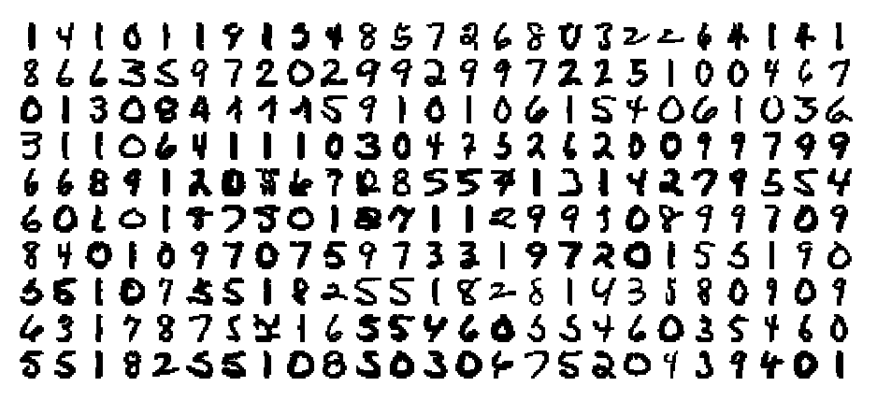
preprocessing
Enough to obtain digits in this format, each one is a 16x16 greyscale image:
Connectionist Computing COMP 30230

Slide 9
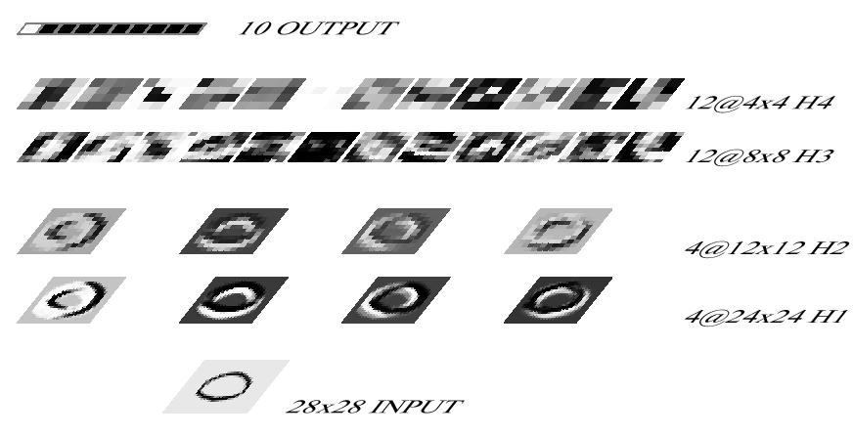
deep network
4 hidden layers:
Connectionist Computing COMP 30230

Slide 10
Results
After 30 epochs the error on the training set was 1.1% and the squared error 0.017.
On the test set: 3.4% and 0.024
To get 1% error: 5.7% rejection (9% on just handwritten)
A lot of these were actually caused by preprocessing. Some of those that weren’t, were ambiguous even to humans.
Connectionist Computing COMP 30230

Slide 11
Invariances
In Le Cun’s paper we saw translation invariance was introduced into the network by weight sharing.
Teaching neural networks invariances is a general problem.
Connectionist Computing COMP 30230

Slide 12
The invariance problem
Our perceptual systems are very good at dealing with invariances
  translation, rotation, scaling
  deformation, contrast, lighting, rate
We are so good at this that it’s hard to appreciate how difficult it is.
  It’s one of the main difficulties in making computers perceive.
  We still don’t have generally accepted solutions.
Connectionist Computing COMP 30230

Slide 13
Invariances: using features
Instead of representing an object directly, extract whatever-invariant features first.
For instance, if we want roto-translational invariance, represent an object by the distances between parts instead of xyz coordinates.
Connectionist Computing COMP 30230

Slide 14
What features?
Some features do not affect the information content of an instance (e.g. distance map vs. xyz coordinates).
Some features, while informative, might involve some information loss.
All features have to be designed. This process may range from completely trivial to years-long and involving the consultation of experts and significant costs.
Connectionist Computing COMP 30230

Slide 15
Invariances: normalisation
For instance put a box around an object, then scale it to a fixed size: same as preprocessing digits in Le Cun et al.
Eliminates degrees of freedom.
Not always trivial how to choose the box.
Connectionist Computing COMP 30230

Slide 16
Invariances: brute force
We can tackle invariances by:
  constraining network weights
  using features
  normalising
But computer scientists should be lazy and impatient. Wouldn’t it be great if we could let the network do all the job?
Brute force: to create invariance to trasformation X, for each example generate a lot of new other examples by applying X to it. Then train a large network on a fast computer.
Connectionist Computing COMP 30230

Slide 17
Invariances: brute force
For example, translate and rotate a digit in a lot of different ways and train a large network to recognise it.
It generally works well, if the transformations aren’t too large: do approximate (easy) normalisation first.
Connectionist Computing COMP 30230

Slide 18
Brute force and Deep Learning
Incidentally, using brute force often also involves adding layers that can tackle a less processed input.
This is in many ways one of the defining elements of Deep Learning, though it's been done plenty of times before Deep Learning was named.
Connectionist Computing COMP 30230

Slide 19
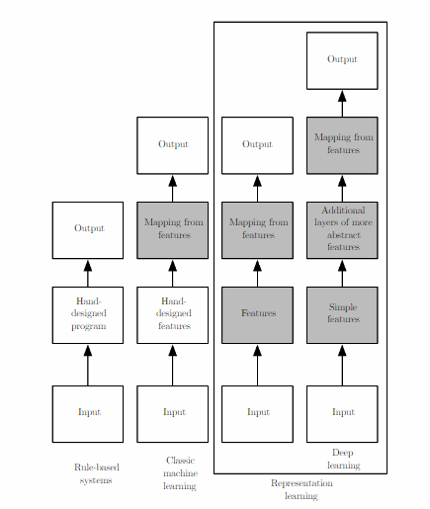
A matter of depth
Connectionist Computing COMP 30230

Slide 20
Summary: invariances
Often as tough a problem as learning after invariances are tackled.
Possible solutions:
  network design
  features
  normalisation
  brute force
Connectionist Computing COMP 30230

